Slide 1
Project
Property Dekho

Slide 2
Developed By
Rohit Mittal

Slide 3
Contents
Introduction
Problem Statement
Data Flow Diagram
Module Of Project
Project Screenshots
Future Scope
Reference

Slide 4
Languages & Framwork Used
FRONTEND
HTML 5
CSS 3
BOOTSTRAP 4
JAVASCRIPT
REACT-JS
BACKEND
NODE-JS
EXPRESS-JS
DATABASE & SHAREING
MONGODB ATLAS
GIT
GITHUB

Slide 5
Introduction
Property Dekho Project is a dynamic website for property business.
Property Dekho Project allows the user to access all the details of property like price, location, owner, amenites, etc.
The main purpose is to help the user to find its desired property and admin to easilly shortlist its property to wide range of customers.
The can used by both user and admin.

Slide 6
Problem Statement
The purpose of this website is on established fact that internet users are inscreasing now-a-days, this website facilitate the user with complete property details that he desires by sitting at home.
Our priority will be our customers and their needs.
There will be many users visiting the portal hence we require a strong and reliable frontend which can with hold the users on our website.
We will be putting our effort on providing the right choice to our customers when they plan thier dream home.

Slide 7
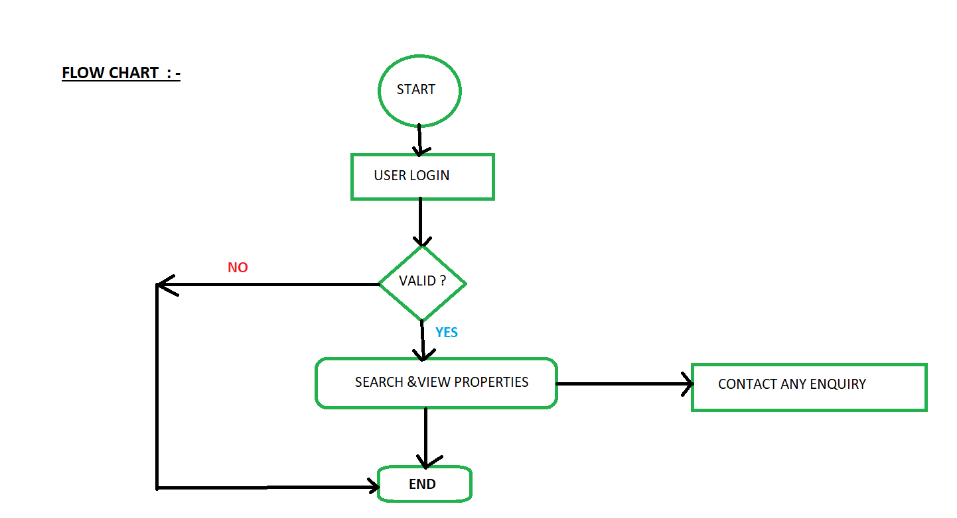
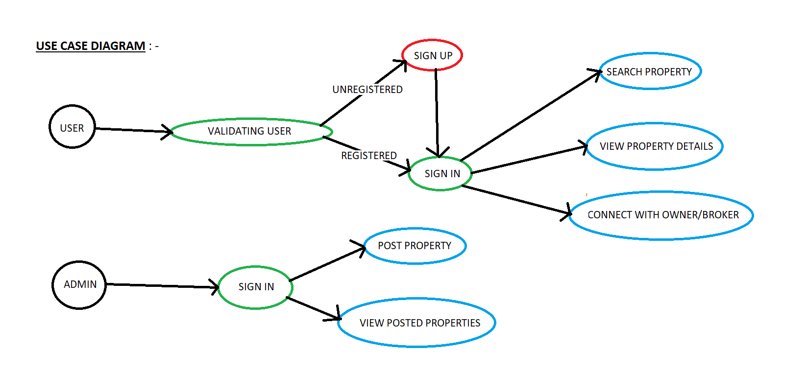
Data Fow Diagram
Flow Chart
Use Case Diagram

Slide 8
Modules of Project
User
Registration (LOGIN)
Search Properties
View Properties
Contact Enquiry
Admin
Registration (LOGIN)
Post Property
View Posted Property
Intrested Customers will Contact

Slide 9
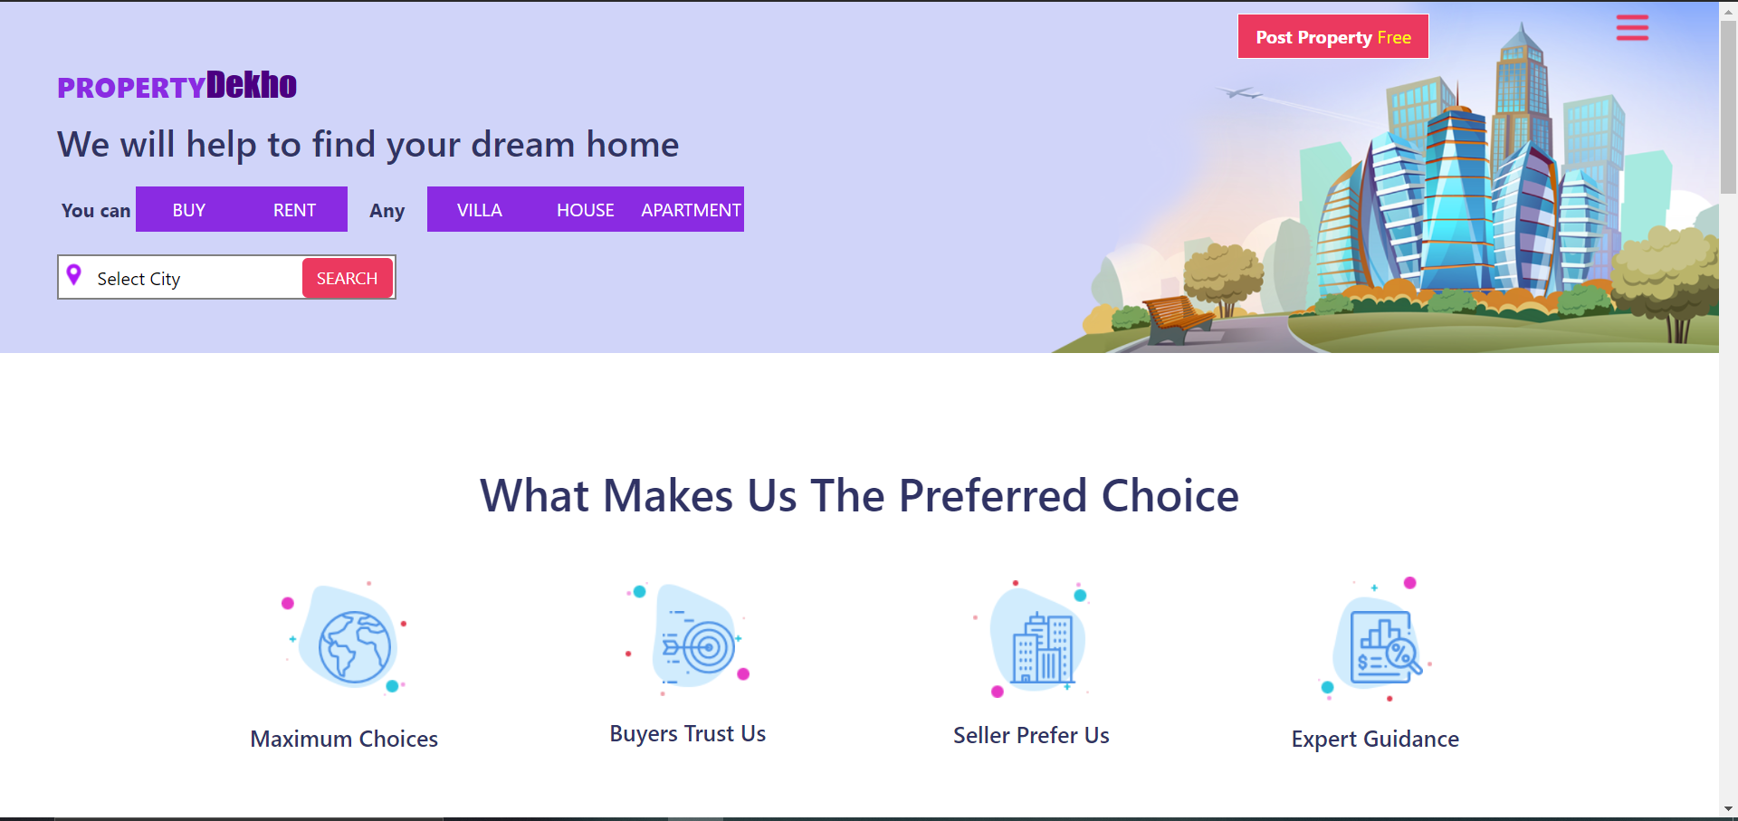
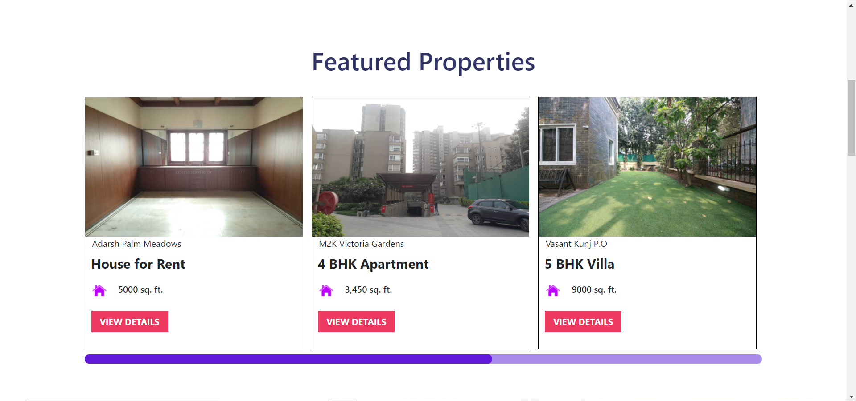
Project Screenshots

Slide 10

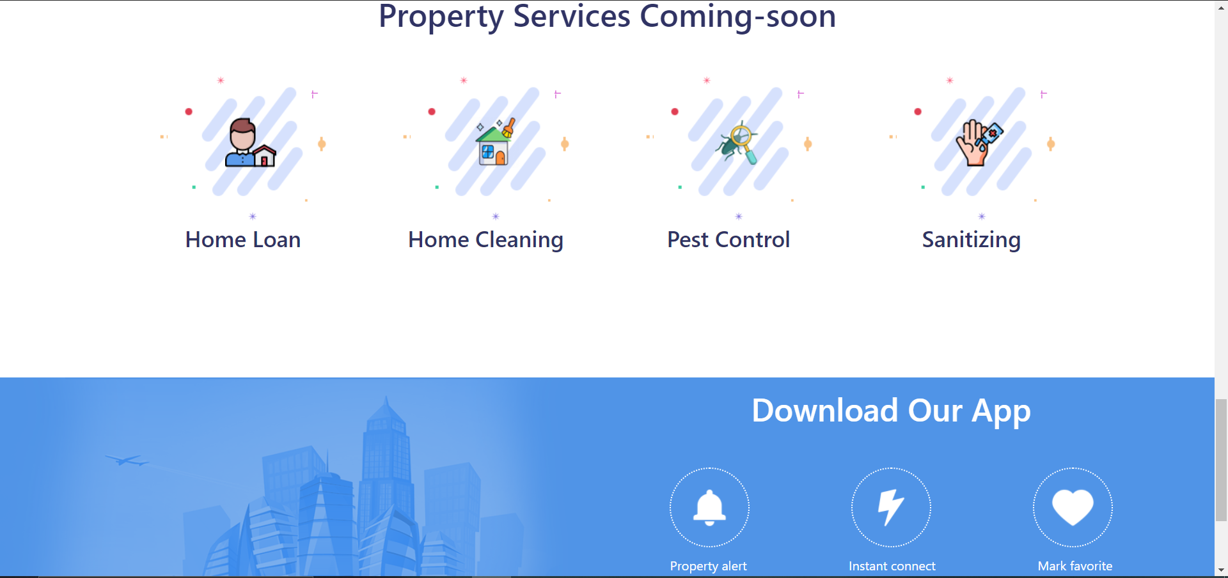

Slide 11
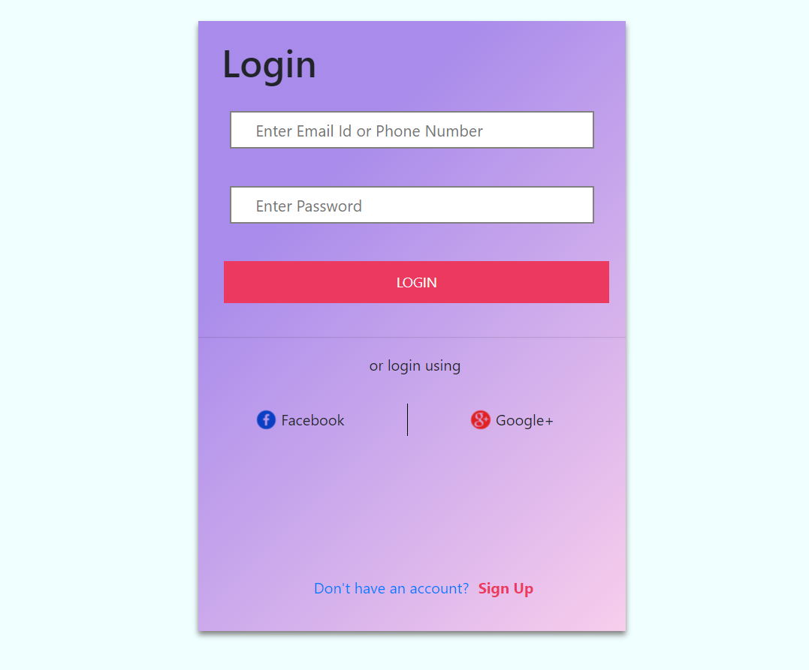
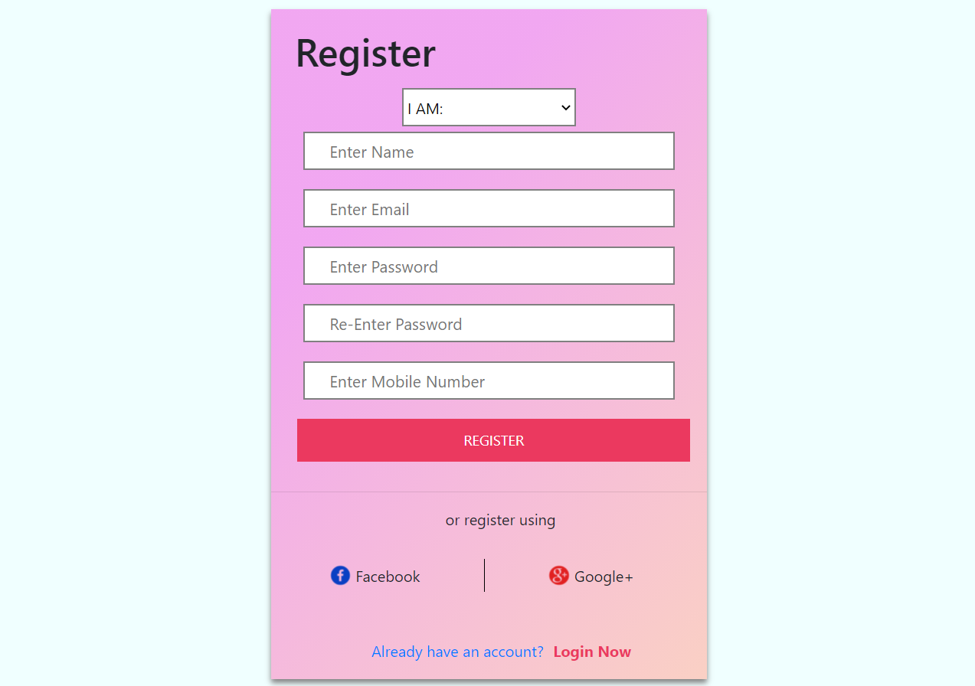
Login & Register

Slide 12
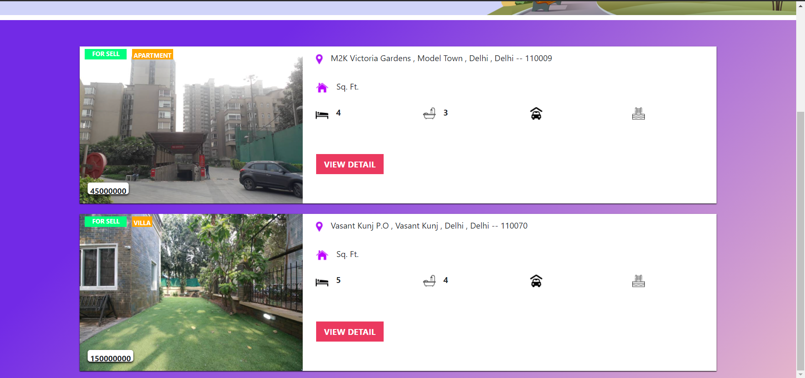
Searched Property

Slide 13
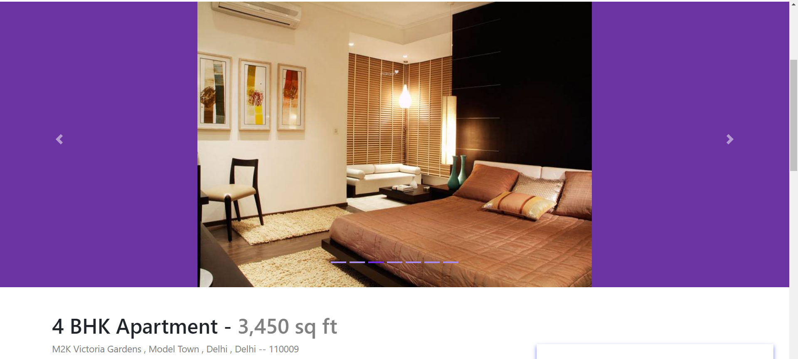
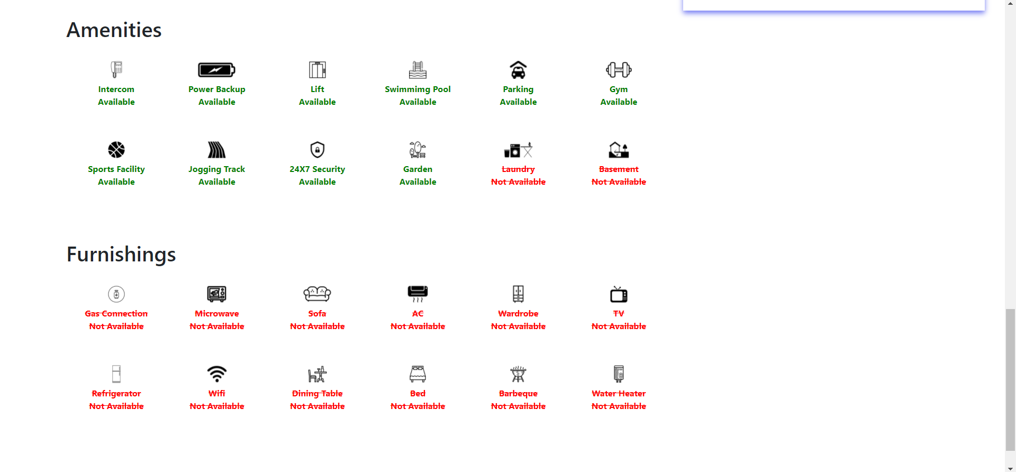
Property Details

Slide 14
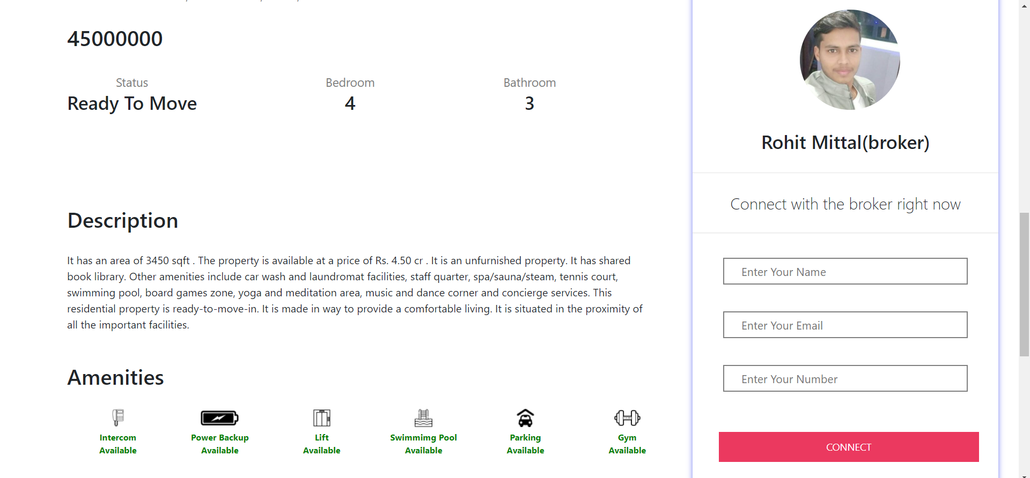
Enquiry Property

Slide 15
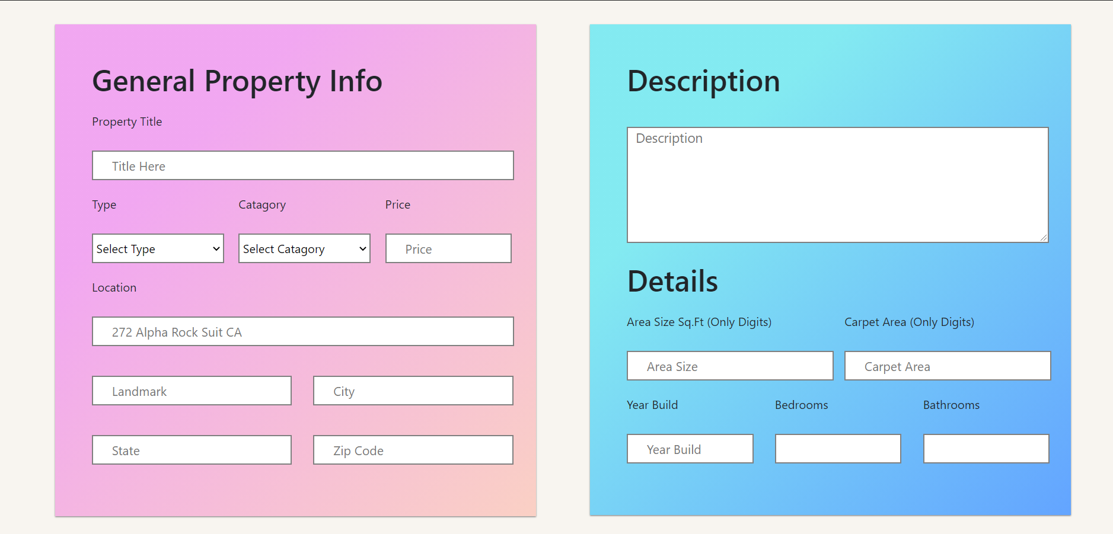
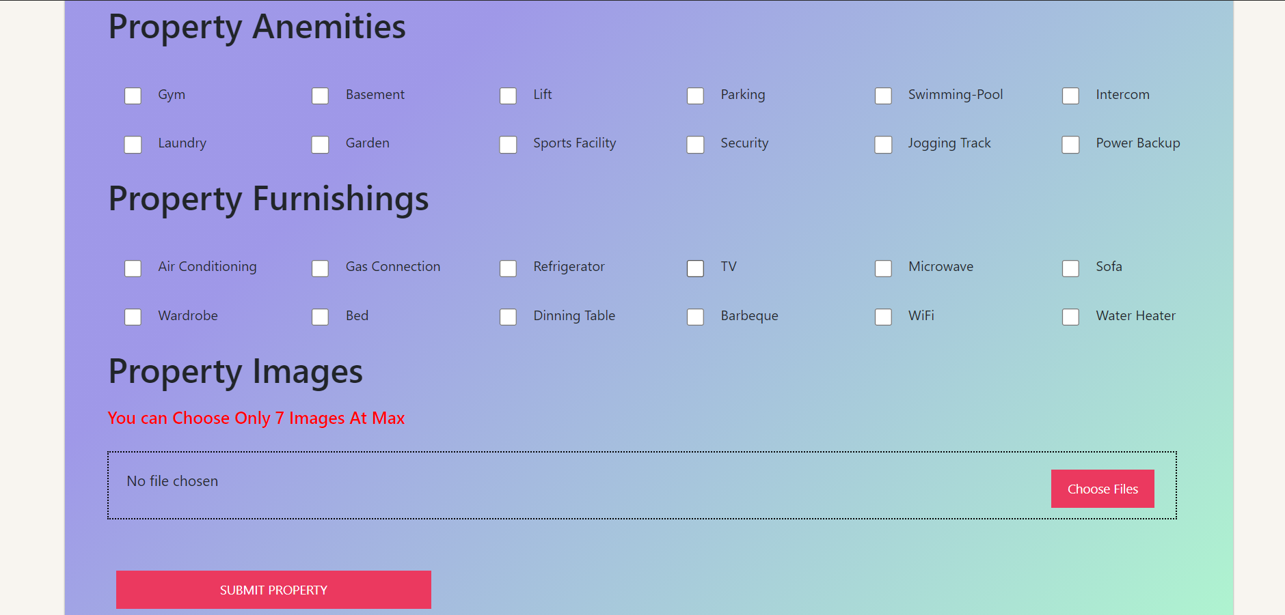
Post Property Form

Slide 16
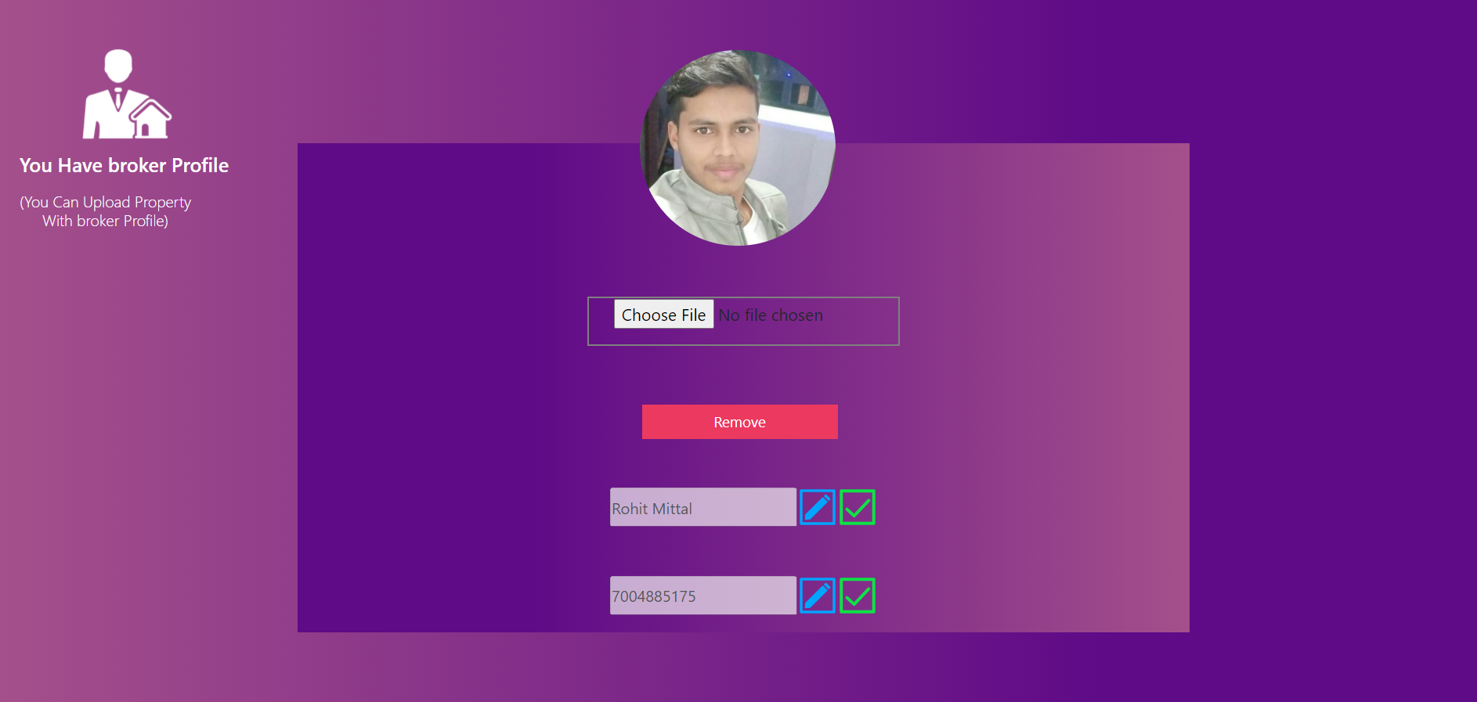
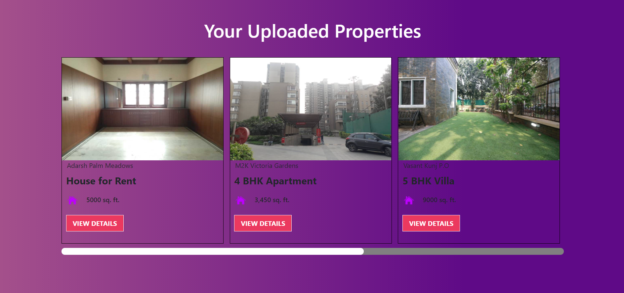
Dashboard

Slide 17
Future Scope
We will include more fuctionality as per the requirement.
We want to improve our home page, as it is the main thing which attracts all users.
Not a single website is ever considered as complete forever firstly because there is always something new requirement that are growing day-by-day

Slide 18
Reference
Special thanks to our guidance teacher
Mr. Sanjay Rathore

Slide 19
THANK YOU

